Slide 1
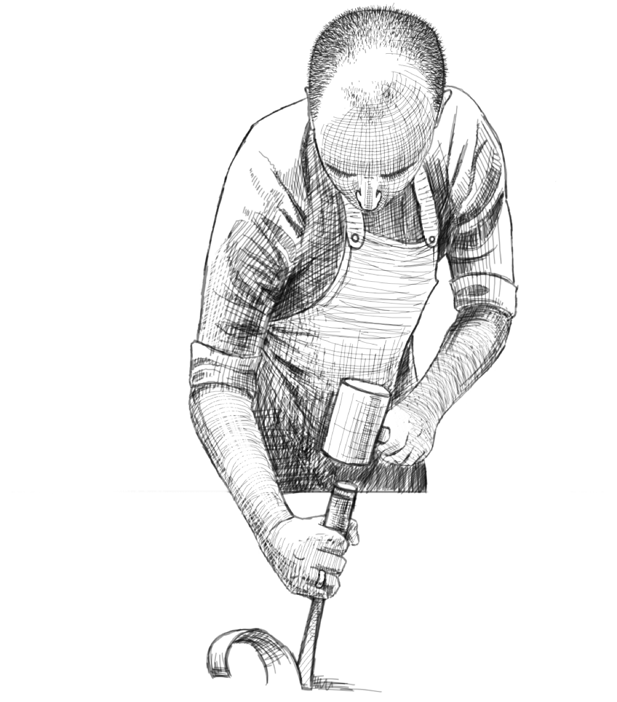
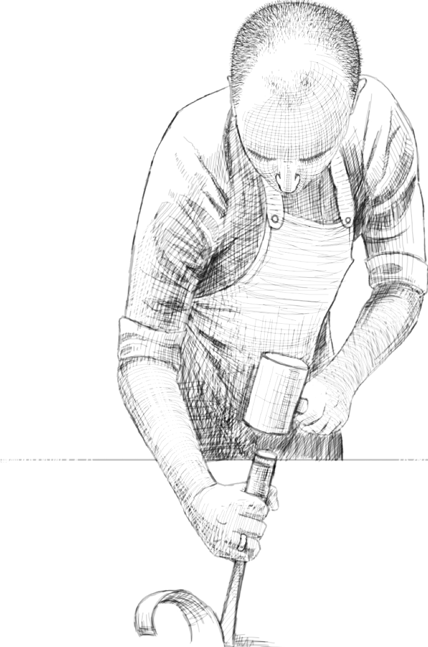
java.util.Comparable
MARCUS BIEL,
Software Craftsman
www.marcus-biel.com
Notes:
Hi, and welcome to my free Java video course. My name is Marcus Biel. In this episode I will talk about the Java interface Comparable. Okay, let’s jump in.

Slide 2
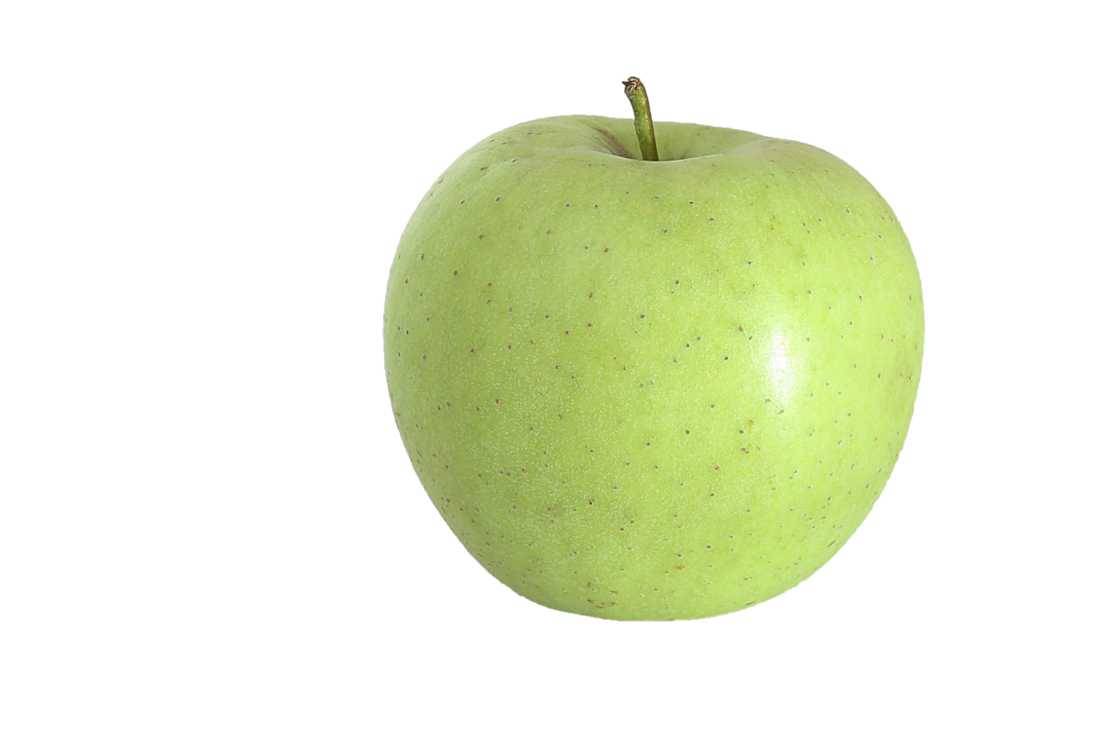
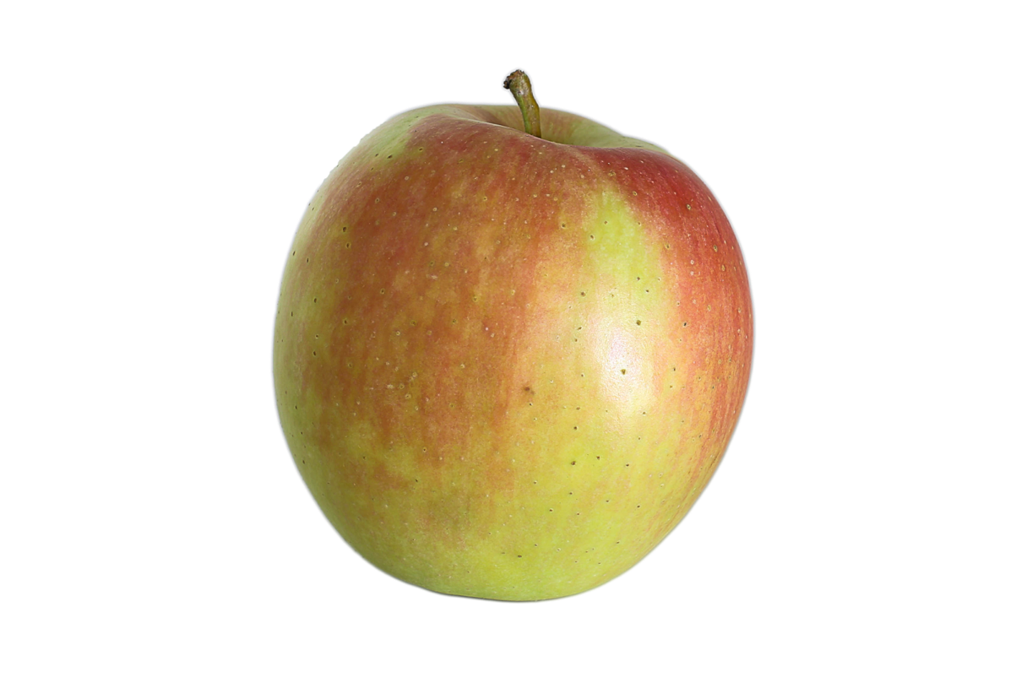
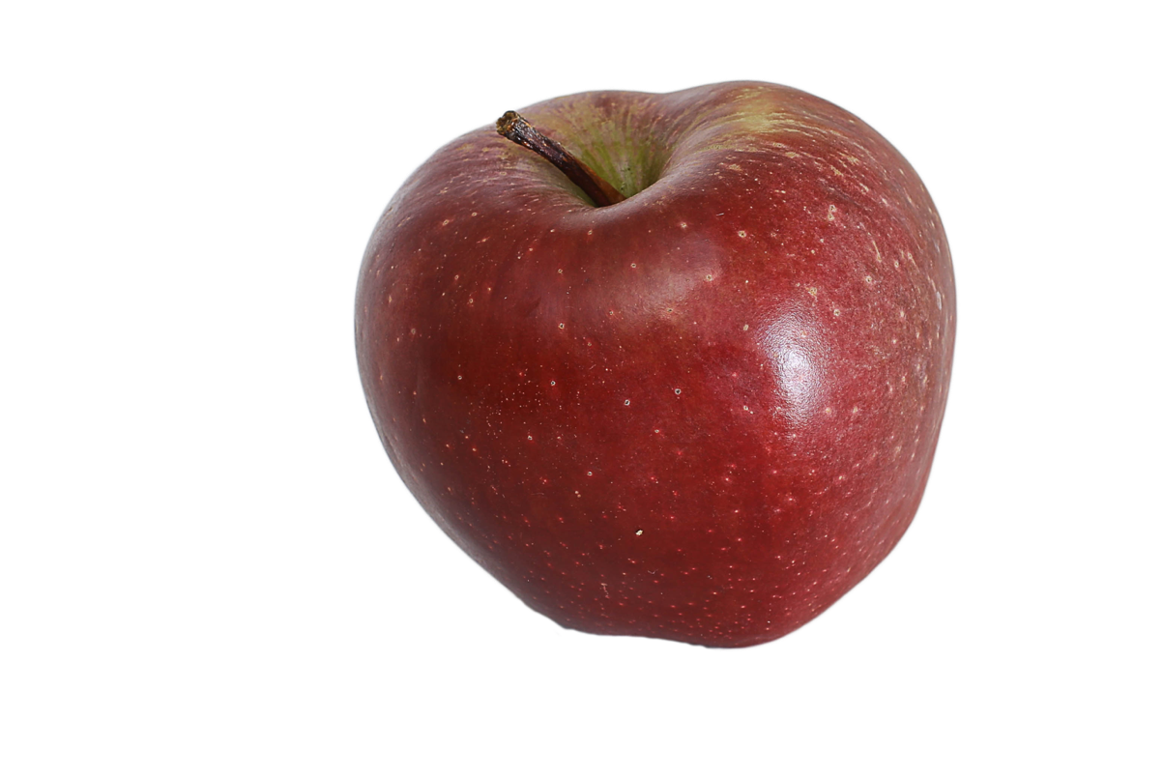
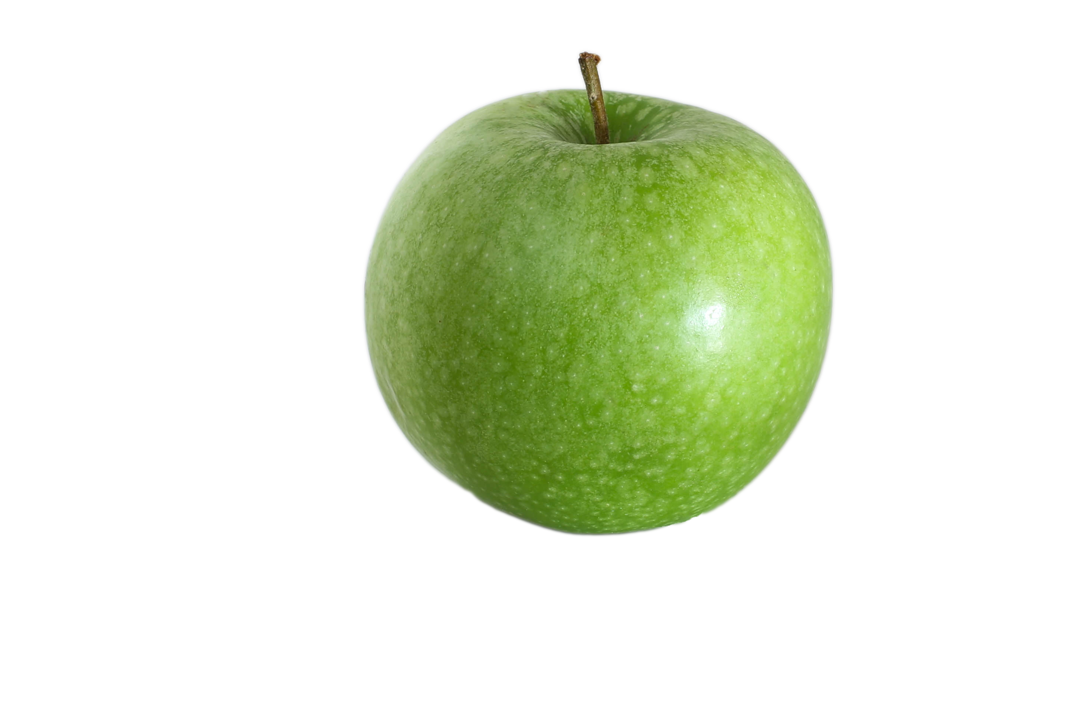
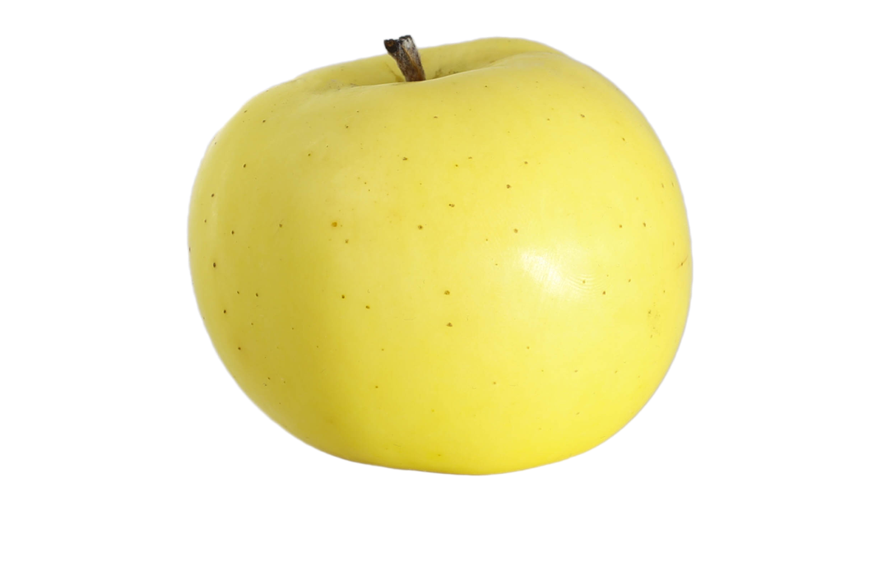
What is Comparable used for?
Notes:
Before getting technical, let me clarify the most important question.

Slide 3
What is Comparable used for?
Notes:
What is the Comparable interface actually used for?

Slide 4
What is Comparable used for?
Notes:
Look at these five apples. If we want to sort them, we must put them in a certain order. To establish this order, we have to compare them with each other.

Slide 5
What is Comparable used for?
Notes:
To do this, we continuously ask the question: Does this apple come before

Slide 6
What is Comparable used for?
Notes:
…that apple?

Slide 7
What is Comparable used for?
Notes:
Until the list is sorted.

Slide 8
What is Comparable used for?
Notes:
Answering that question is what the Comparable interface does.

Slide 9
What is Comparable used for?
Notes:
In a nutshell, while Comparable is used in the sorting process, it cannot sort the Objects on its own.

Slide 10
Comparable Interface
int compareTo(T other);
Notes:
The Comparable interface defines just one method - int compareTo. T is a generic type, in our case it will be the type Apple.

Slide 11
Comparable Interface
.compareTo( )
Notes:
As a concrete example, you call the compareTo method on one apple, and you give it another apple to compare itself to.

Slide 12
Comparable Interface
.compareTo( )
Notes:
So in our example the result of the comparison could be…

Slide 13
Comparable Interface
less than
Notes:
..less than…

Slide 14
Comparable Interface
equal to
Notes:
…equal to..

Slide 15
Comparable Interface
greater than
Notes:
or greater than the other apple.

Slide 16
Comparable Interface
.compareTo( )
Notes:
But how do we know if one apple is actually less than, equal to, or greater than the other apple?

Slide 17
Less Than
.compareTo( )
Notes:
If this apple is considered less than the other apple, we have to return an arbitrary negative number;

Slide 18
Less Than
return -454;
Notes:
-454 for example.

Slide 19
Equal to
.compareTo( )
Notes:
If both apples are considered equal,

Slide 20
Equal to
return 0;
Notes:
we have to return 0.

Slide 21
Greater Than
.compareTo( )
Notes:
Finally, if this apple is considered greater than then the other apple, we have to return an arbitrary positive number -

Slide 22
Greater Than
return 42;
Notes:
42, for example.

Slide 23
What does “less” mean?
Notes:
Until now, we have used apples of various sizes to emphasize how one apple might differ from another.

Slide 24
What does “less” mean?
Notes:
However, that’s not the whole story.

Slide 25
What does “less” mean?
Notes:
There are many OTHER characteristics that could be used to sort Apples. I just used the size for illustrative purposes.

Slide 26
What does “less” mean?
Notes:
First, our client must precisely define how he wants the apples to be sorted.

Slide 27
What does “less” mean?
Notes:
Does he want the apples sorted by variety?

Slide 28
What does “less” mean?
Notes:
And what does “sorted by variety” actually mean?

Slide 29
What does “less” mean?
Notes:
For example, we could sort the apples - alphabetically by variety name - or - by the variety unit price.

Slide 30
What does “less” mean?
Notes:
Second, our client must clarify what “less than”, “equal to” and “greater than” mean to him.

Slide 31
What does “less” mean?
Notes:
As an example, our client might decide to sort by the apple’s color.

Slide 32
What does “less” mean?
Notes:
In this case - which color will be first, second and third?

Slide 33
What does “less” mean?
Notes:
It’s even possible to sort by multiple characteristics - which we will see in an example later.

Slide 34
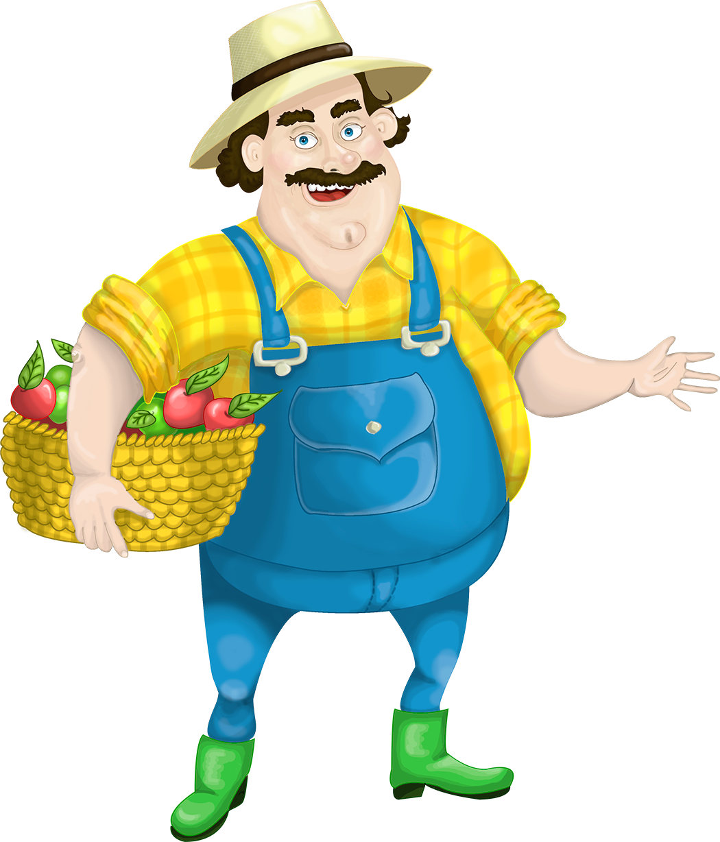
Implementing Comparable
Notes:
Okay, let’s put all this into practice.

Slide 35
Implementing Comparable
Notes:
May I introduce you to Fatty-Farmer, our client.

Slide 36
Implementing Comparable
Notes:
As you might have guessed, he wants us to write a program that will sort his apples.

Slide 37
Implementing Comparable
Notes:
In the first version, he wants the apples sorted by weight.

Slide 38
Implementing Comparable
Collections.sort(apples);
Notes:
Implementing the sorting logic is quite simple. We can do it with just one line of code.

Slide 39
Implementing Comparable
Collections.sort(apples);
Notes:
Collections.sort will do it it all for us. If - well if we defined how to compare apples beforehand.

Slide 40
Implementing Comparable
Apple
variety color weight
Notes:
But one step at a time. Based on the farmer’s requirements, we first have to design an Apple class.

Slide 41
Implementing Comparable
Apple
variety color weight
Notes:
In our example, every Apple has a variety, a color, and a weight.

Slide 42
Implementing Comparable
Apple
String variety; Color color; int weight;
Notes:
For illustrative purposes - keeping things simple -

Slide 43
Implementing Comparable
Apple
String variety; Color color; int weight;
Notes:
the variety will be represented as a String, the color as an enum and the weight as a primitive int.

Slide 44
A first version…
public class Apple {
private String variety;
private Color color;
private int weight;
[…]
}
Notes:
So here is our first version of class Apple.

Slide 45
A first version…
public class Apple {
private String variety;
private Color color;
private int weight;
[…]
}
Notes:
Because our program will sort apples, the Apple class needs to implement the Comparable interface, so let’s quickly add that…

Slide 46
A first version…
public class Apple implements Comparable<Apple> {
private String variety;
private Color color;
private int weight;
[…]
}
Notes:
Comparable is a generic interface.

Slide 47
A first version…
public class Apple implements Comparable<Apple> {
private String variety;
private Color color;
private int weight;
[…]
}
Notes:
With Apple in angle brackets, we define that an object of type Apple can be compared to other Apple objects.

Slide 48
A first version…
public class Apple implements Comparable<Apple> {
private String variety;
private Color color;
private int weight;
@Override
public int compareTo(Apple other) {
// TODO implement compareTo method
}
[…]
}
Notes:
Okay, now it starts to get exciting. We’re now ready to implement our first compareTo method.

Slide 49
A first version…
public class Apple implements Comparable<Apple> {
private String variety;
private Color color;
private int weight;
@Override
public int compareTo(Apple other) {
// TODO implement compareTo method
}
[…]
}
Notes:
As I said before, in this first version, we will compare apples by weight.

Slide 50
A first version…
@Override
public int compareTo(Apple other) {
if (this.weight < other.weight) {
[…]
}
}
Notes:
So we add a first if-condition for the case that this weight is less than the other apple’s weight.

Slide 51
A first version…
@Override
public int compareTo(Apple other) {
if (this.weight < other.weight) {
[…]
}
}
Notes:
Do you remember what we have to return in this case? Pause the video, and think about it.

Slide 52
A first version…
@Override
public int compareTo(Apple other) {
if (this.weight < other.weight) {
// return negative number
}
}
Notes:
Exactly, a negative number.

Slide 53
A first version…
@Override
public int compareTo(Apple other) {
if (this.weight < other.weight) {
return -1;
}
}
Notes:
To keep it simple, let’s return -1.

Slide 54
A first version…
@Override
public int compareTo(Apple other) {
if (this.weight < other.weight) {
return -1;
}
if (this.weight == other.weight) {
[…]
}
}
Notes:
What do we have to return if both weights are equal? Pause the video, and think about it.

Slide 55
A first version…
@Override
public int compareTo(Apple other) {
if (this.weight < other.weight) {
return -1;
}
if (this.weight == other.weight) {
return 0;
}
}
Notes:
0. Exactly.

Slide 56
A first version…
@Override
public int compareTo(Apple other) {
if (this.weight < other.weight) {
return -1;
}
if (this.weight == other.weight) {
return 0;
}
}
Notes:
Now if this weight is not less than or equal to the other weight, then it must be more than the other weight.

Slide 57
A first version…
@Override
public int compareTo(Apple other) {
if (this.weight < other.weight) {
return -1;
}
if (this.weight == other.weight) {
return 0;
} […]
}
Notes:
Therefore, we don’t need a third if-statement and can directly return the value that represents “greater than”.

Slide 58
A first version…
@Override
public int compareTo(Apple other) {
if (this.weight < other.weight) {
return -1;
}
if (this.weight == other.weight) {
return 0;
} […]
}
Notes:
Do you still remember what we have to return in this case? Pause the video and think about it.

Slide 59
A first version…
@Override
public int compareTo(Apple other) {
if (this.weight < other.weight) {
return -1;
}
if (this.weight == other.weight) {
return 0;
} // return positive number }
Notes:
Exactly. A positive number.

Slide 60
A first version…
@Override
public int compareTo(Apple other) {
if (this.weight < other.weight) {
return -1;
}
if (this.weight == other.weight) {
return 0;
} return 1; }
Notes:
Let’s return “1” to counter the “-1” from the first condition.

Slide 61
A first version…
@Override
public int compareTo(Apple other) {
if (this.weight < other.weight) {
return -1;
}
if (this.weight == other.weight) {
return 0;
} return 1; }
Notes:
Okay. We have successfully implemented our first compareTo method!

Slide 62
A first version…
@Override
public int compareTo(Apple other) {
if (this.weight < other.weight) {
return -1;
}
if (this.weight == other.weight) {
return 0;
} return 1; }
Notes:
Hooray! Fireworks! Party time!

Slide 63
A first version…
@Override
public int compareTo(Apple other) {
if (this.weight < other.weight) {
return -1;
}
if (this.weight == other.weight) {
return 0;
} return 1; }
Notes:
Now let’s take a closer look at our compareTo implementation.

Slide 64
A first version…
@Override
public int compareTo(Apple other) {
if (this.weight < other.weight) {
return -1;
}
if (this.weight == other.weight) {
return 0;
} return 1; }
Notes:
Can you think of an easier way to do this? Pause the video, and think about it for a moment.

Slide 65
An improved version …
@Override
public int compareTo(Apple other) {
if (this.weight < other.weight) {
return -1;
}
if (this.weight == other.weight) {
return 0;
} return 1; }
Notes:
Well. Do you think we are the first developers comparing two int values with each other?

Slide 66
An improved version …
@Override
public int compareTo(Apple other) {
if (this.weight < other.weight) {
return -1;
}
if (this.weight == other.weight) {
return 0;
} return 1; }
Notes:
Probably not! It’s generally better to reuse existing code, than to reinvent the wheel.

Slide 67
An improved version …
@Override
public int compareTo(Apple other) {
if (this.weight < other.weight) {
return -1;
}
if (this.weight == other.weight) {
return 0;
} return 1; }
Notes:
The best code is the code that was never written.

Slide 68
An improved version …
@Override
public int compareTo(Apple other) {
if (this.weight < other.weight) {
return -1;
}
if (this.weight == other.weight) {
return 0;
} return 1; }
Notes:
So now the idea is to replace this code block, by calling an existing method to do the heavy work for us.

Slide 69
An improved version …
@Override
public int compareTo(Apple other) {
return this.weight.compareTo(other.weight);
}
Notes:
Something like this, for example.

Slide 70
An improved version …
@Override
public int compareTo(Apple other) {
return this.weight.compareTo(other.weight);
}
Cannot invoke compareTo(int) on the primitive type int
Notes:
However, this not quite the whole story, because weight is not an object, but a primitive int value, which does not provide a compareTo method.

Slide 71
An improved version …
@Override
public int compareTo(Apple other) {
//return this.weight.compareTo(other.weight);
}
Notes:
The primitive int has a corresponding Integer Wrapper type.

Slide 72
An improved version …
@Override
public int compareTo(Apple other) {
return Integer.compare(this.weight, other.weight);
}
Notes:
It provides the static method compare, that we can use to compare two primitive int values.

Slide 73
An improved version …
@Override
public int compareTo(Apple other) {
return Integer.compare(this.weight, other.weight);
}
Notes:
So this single line of code is equivalent…

Slide 74
An improved version …
@Override
public int compareTo(Apple other) {
if (this.weight < other.weight) {
return -1;
}
if (this.weight == other.weight) {
return 0;
} return 1; }
Notes:
to our previous version.

Slide 75
Comparable Implementations
Primitive Wrappers
(Byte, Short, Integer, Long, Float, Double, Boolean, Character)
String
Enum
Notes:
There are many classes in the JDK that implement the Comparable interface. For example all Primitive Wrapper classes, as well as String and enum.

Slide 76
Using multiple characteristics
Notes:
Okay. So Fatty Farmer was very happy with our program.

Slide 77
Using multiple characteristics
Notes:
Now that he sees what is generally possible, of course he wants “just another little feature”.

Slide 78
Using multiple characteristics
Notes:
For version two, Fatty Farmer wants us to sort by multiple characteristics.

Slide 79
Using multiple characteristics
Notes:
First, he want us to sort the apples by variety.

Slide 80
Using multiple characteristics
Notes:
However, when two apples have the same variety, he wants us to sort them by color.

Slide 81
Using multiple characteristics
Notes:
Finally, if both variety and color are the same, he wants us to sort the apples by weight.

Slide 82
Using multiple characteristics
Notes:
But this time we will make use of the compareTo methods provided by String, enum and Integer.

Slide 83
An improved version …
@Override
public int compareTo(Apple other) {
int result = this.variety.compareTo(other.variety);
}
Notes:
So as requested by Fatty Farmer, we start by comparing the variety.

Slide 84
An improved version …
@Override
public int compareTo(Apple other) {
int result = this.variety.compareTo(other.variety);
if(result != 0){
return result;
}
}
Notes:
If the result is not zero, it means our apples are not of the same variety and we can leave the method.

Slide 85
An improved version …
@Override
public int compareTo(Apple other) {
int result = this.variety.compareTo(other.variety);
if(result != 0){
return result;
}
if (result == 0) {
result = this.color.compareTo(other.color);
}
}
Notes:
However, if the two apples are of the same variety, we have to compare the apples’ color.

Slide 86
An improved version …
@Override
public int compareTo(Apple other) {
int result = this.variety.compareTo(other.variety);
if(result != 0){
return result;
}
if (result == 0) {
result = this.color.compareTo(other.color);
}
if(result != 0){
return result;
}
}
Notes:
Now the same condition applies, if they have different colors, we can leave the method.

Slide 87
An improved version …
@Override
public int compareTo(Apple other) {
int result = this.variety.compareTo(other.variety);
if(result != 0){
return result;
}
if (result == 0) {
result = this.color.compareTo(other.color);
}
if(result != 0){
return result;
}
if (result == 0) {
result = Integer.compare(this.weight, other.weight);
}
}
Notes:
However if both apples have the same variety and color, we do need to compare their weights.

Slide 88
Using multiple characteristics
@Override
public int compareTo(Apple other) {
int result = this.variety.compareTo(other.variety);
if(result != 0){
return result;
}
if (result == 0) {
result = this.color.compareTo(other.color);
}
if(result != 0){
return result;
}
if (result == 0) {
result = Integer.compare(this.weight, other.weight);
}
return result;
}
Notes:
Finally, we return the result.

Slide 89
Using multiple characteristics
@Override
public int compareTo(Apple other) {
int result = this.variety.compareTo(other.variety);
if(result != 0){
return result;
}
if (result == 0) {
result = this.color.compareTo(other.color);
}
if(result != 0){
return result;
}
if (result == 0) {
result = Integer.compare(this.weight, other.weight);
}
return result;
}
Notes:
Now look at the code we implemented. Are you happy with it? Is there something you would like to improve? Pause the video, and think about it.

Slide 90
Using multiple characteristics
@Override
public int compareTo(Apple other) {
int result = this.variety.compareTo(other.variety);
if(result != 0){
return result;
}
if (result == 0) {
result = this.color.compareTo(other.color);
}
if(result != 0){
return result;
}
if (result == 0) {
result = Integer.compare(this.weight, other.weight);
}
return result;
}
Notes:
Exactly! It contains duplicate code! And duplicate code is EVIL, so let’s clean that up.

Slide 91
Using multiple characteristics
@Override
public int compareTo(Apple other) {
int result = this.variety.compareTo(other.variety);
if(result != 0){
return result;
}
if (result == 0) {
result = this.color.compareTo(other.color);
}
if(result != 0){
return result;
}
if (result == 0) {
result = Integer.compare(this.weight, other.weight);
}
return result;
}
Notes:
As you can see, these two code blocks are executed only if the result is zero. That means if the result is not zero, both blocks will be skipped.

Slide 92
Using multiple characteristics
@Override
public int compareTo(Apple other) {
int result = this.variety.compareTo(other.variety);
if (result == 0) {
result = this.color.compareTo(other.color);
}
if (result == 0) {
result = Integer.compare(this.weight, other.weight);
}
return result;
}
Notes:
Therefore, we can simply remove the two other code blocks.

Slide 93
Using multiple characteristics
@Override
public int compareTo(Apple other) {
int result = this.variety.compareTo(other.variety);
if (result == 0) {
result = this.color.compareTo(other.color);
}
if (result == 0) {
result = Integer.compare(this.weight, other.weight);
}
return result;
}
Notes:
This by the way, is a good example of what you do as a Clean Coder too. Usually, you don’t instantly write Clean Code.

Slide 94
Using multiple characteristics
@Override
public int compareTo(Apple other) {
int result = this.variety.compareTo(other.variety);
if (result == 0) {
result = this.color.compareTo(other.color);
}
if (result == 0) {
result = Integer.compare(this.weight, other.weight);
}
return result;
}
Notes:
You start with a rough idea, make it work, and then continuously improve it until you can feel that it’s clean.

Slide 95
Using multiple characteristics
@Override
public int compareTo(Apple other) {
int result = this.variety.compareTo(other.variety);
if (result == 0) {
result = this.color.compareTo(other.color);
}
if (result == 0) {
result = Integer.compare(this.weight, other.weight);
}
return result;
}
Notes:
Okay, let’s get back to the Comparable interface, there are a few more things I would like to tell you.

Slide 96
Comparable, hashCode and equals
@Override
public int compareTo(Apple other) {
int result = this.variety.compareTo(other.variety);
if (result == 0) {
result = this.color.compareTo(other.color);
}
if (result == 0) {
result = Integer.compare(this.weight, other.weight);
}
return result;
}
Notes:
You may have noticed that the compareTo method resembles the hashCode and equals methods to some extent.

Slide 97
Comparable, hashCode and equals
@Override
public int compareTo(Apple other) {
int result = this.variety.compareTo(other.variety);
if (result == 0) {
result = this.color.compareTo(other.color);
}
if (result == 0) {
result = Integer.compare(this.weight, other.weight);
}
return result;
}
Notes:
However, there is an important difference.

Slide 98
Comparable, hashCode and equals
@Override
public int compareTo(Apple other) {
int result = this.variety.compareTo(other.variety);
if (result == 0) {
result = this.color.compareTo(other.color);
}
if (result == 0) {
result = Integer.compare(this.weight, other.weight);
}
return result;
}
Notes:
For hashCode and equals, the order in which you compare individual attributes, has a big impact on the performance, but it does not influence the value returned.

Slide 99
Comparable, hashCode and equals
@Override
public int compareTo(Apple other) {
int result = this.variety.compareTo(other.variety);
if (result == 0) {
result = this.color.compareTo(other.color);
}
if (result == 0) {
result = Integer.compare(this.weight, other.weight);
}
return result;
}
Notes:
However, the order in which you compare attributes in the compareTo method defines the way in which the objects will be sorted.

Slide 100
Using Comparable
Notes:
In conclusion, the Comparable interface is one of the most important interfaces in Java.

Slide 101
Using Comparable
java.util.Arrays
java.util.Collections
Notes:
For example, it is used by the two utility classes java.util.Arrays and java.util.Collections to sort elements and to search for elements in sorted collections.

Slide 102
Using Comparable
java.util.TreeSet java.util.TreeMap
Notes:
With collections like TreeSet or TreeMap its even easier -
they automatically sort their elements which have to implement the Comparable interface.

